Slide 1


BOOTSTRAP
Lecture-8

Slide 2
Today’s Agenda
BootStrap Cards
Card , Card Body, Card Text
Using Images
Using List Groups With Card
Using Background Colors
Different Types Of Cards

Slide 3
BootStrap Cards
A card is a content container that is flexible and easy to extend.
Coming with a variety and components and options for styling and aligning, Bootstrap 5 cards offer extensive use-cases

Slide 4
Card Body
The main class that offers the card functionalities is the .card class.
All other components go inside the .card element.

Slide 5
Card Body
The main building block of a Card is the card body.
The body offers a padded content region that takes up the entire width of its Card.
To add a body to the card, we need the .card-body class.

Slide 6
Example
<div class="container">
<div class="row">
<div class="col">
<div class="card">
<div class="card-body">Hello world!</div>
</div>
</div>
</div>
</div>

Slide 7
Output

Slide 8
Card Title
To add a title to our card, we can add the .card-title class to an <h[size]> element.
And to add a subtitle, we can use the .card-subtitle card on the <h[size]> elements.

Slide 9
Card Title
To align the items with the rest of the content, it is preferable to add titles and subtitles inside the .card-body.
For adding a block of text inside the .card-body without any extra styling, we can use the .card-text class.

Slide 10
Example
<div class="card">
<div class="card-body">
<h4 class="card-title">Bhopal</h1>
<h6 class="card-subtitle mb-2 text-muted">Capital city of Madhya Pradesh</h2>
<p class="card-text">Bhopal is the capital city of the Indian state of Madhya Pradesh ...
</p>
</div>
</div>

Slide 11
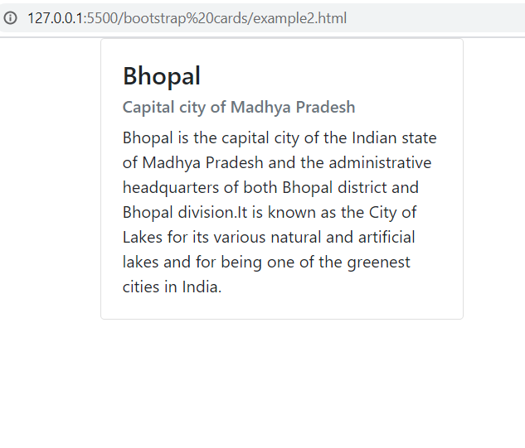
Output

Slide 12
Card Links
To add links to our Card, we can use the .card-link class on the <a> tag.
This ensures that our links are nicely aligned if we have more than one positioned on a single line.

Slide 13
Example
<div class="card">
<div class="card-body">
<h4 class="card-title">Bhopal</h1>
<h6 class="card-subtitle mb-2 text-muted">Capital city of Madhya Pradesh</h2>
<p class="card-text">Bhopal is the capital city of the Indian state of Madhya Pradesh ...
</p>
<a href="#" class="card-link">Read More</a>
<a href="#" class="card-link">Book a Trip</a>
</div>
</div>

Slide 14
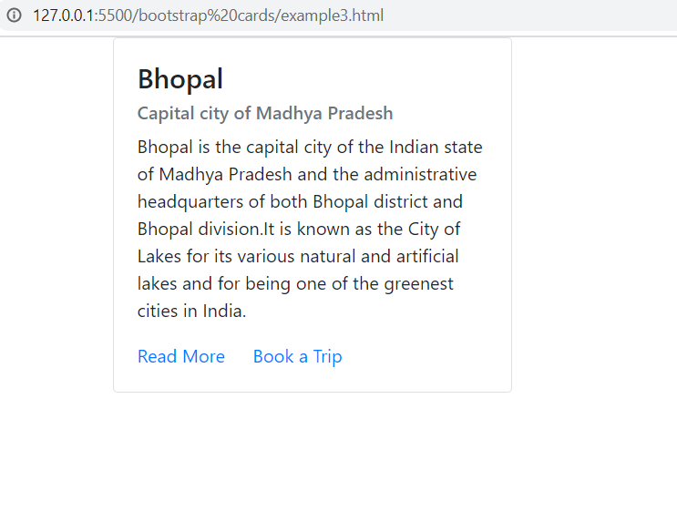
Output

Slide 15
Card Images
Cards have multiple options for adding images.
We can choose to add an image as a cap to the top
We can choose to add an image as a footer to the bottom
We can have it as a background, with the content being displayed over it.

Slide 16
Image On Top
To add an image to the top of a card, we need to place the image as the first element before the .card-body.
In order to have it aligned with the rest of the card, it needs the .card-img-top class

Slide 17
Example
<div class="card">
<img class="card-img-top" src="../images/bhopal2.jpg" alt="Bhopal">
<div class="card-body">
<h4 class="card-title">Bhopal</h1>
<h6 class="card-subtitle mb-2 text-muted">Capital city of Madhya Pradesh</h2>
<p class="card-text">Bhopal is the capital city of the Indian state of Madhya Pradesh ...
</p>
<a href="#" class="card-link">Read More</a>
<a href="#" class="card-link">Book a Trip</a>
</div>
</div>

Slide 18
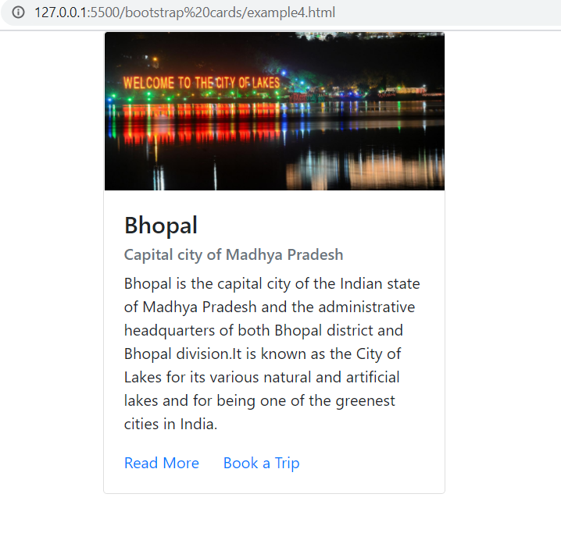
Output

Slide 19
Image At Bottom
If we want to add an image cap at the bottom of the card, we can use the .card-img-bottom class on an <img> tag placed after the .card-body.

Slide 20
Example
<div class="card">
<div class="card-body">
<h4 class="card-title">Bhopal</h1>
<h6 class="card-subtitle mb-2 text-muted">Capital city of Madhya Pradesh</h2>
<p class="card-text">Bhopal is the capital city of the Indian state of Madhya Pradesh ...
</p>
<a href="#" class="card-link">Read More</a>
<a href="#" class="card-link">Book a Trip</a>
</div>
<img class="card-img-bottom” src="../images/bhopal2.jpg" alt="Bhopal">
</div>

Slide 21
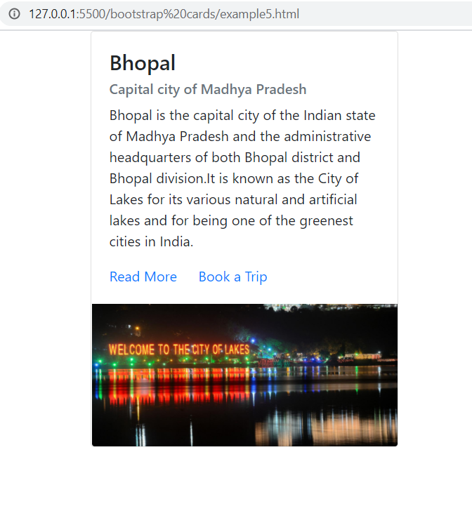
Output

Slide 22
Image Overlays
To have an image as the background of the Card we need to add the .card-img class.
And in order to place content over it, we will need to use the .card-img-overlay class.
We will need to place all our components inside the overlay.

Slide 23
Example
<div class="card">
<img class="card-img" src="../images/bhopal.jpg" alt="Bhopal">
<div class="card-img-overlay text-white d-flex flex-column justify-content-center">
<h4 class="card-title">Bhopal</h1>
<h6 class="card-subtitle mb-2 text-muted">Capital city of Madhya Pradesh</h2>
<p class="card-text">Bhopal is the capital city of the Indian state of Madhya Pradesh ...
</p>
<a href="#" class="card-link">Read More</a>
<a href="#" class="card-link">Book a Trip</a>
</div>
</div>

Slide 24
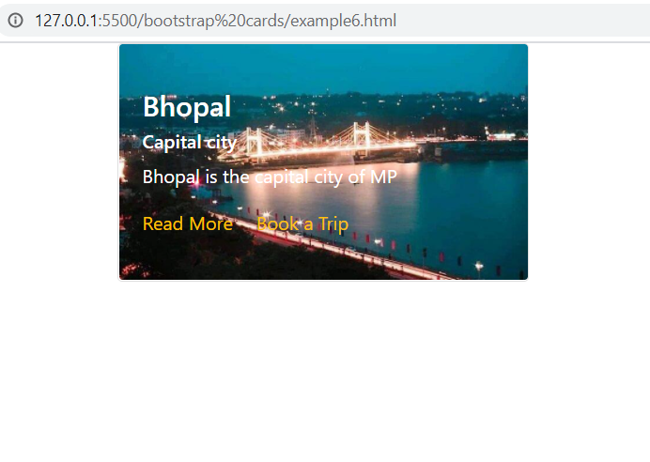
Output

Slide 25
Card Headers
We have two options to add a header to a Bootstrap 5 card.
We can create and add the .card-header to a <div> that will contain the elements we want to have in the header.
We can add the .card-header class directly to a <h[size]> tag.

Slide 26
Example
<div class="card">
<div class="card-header">
Book My Trip
</div>
<div class="card-body">
<h4 class="card-title">Bhopal</h1>
<h6 class="card-subtitle mb-2 text-muted">Capital city of Madhya Pradesh</h2>
<p class="card-text">Bhopal is the capital city of the Indian state of Madhya Pradesh ...
</p>
<a href="#" class="btn btn-danger">Get The Deal</a> </div>
</div>

Slide 27
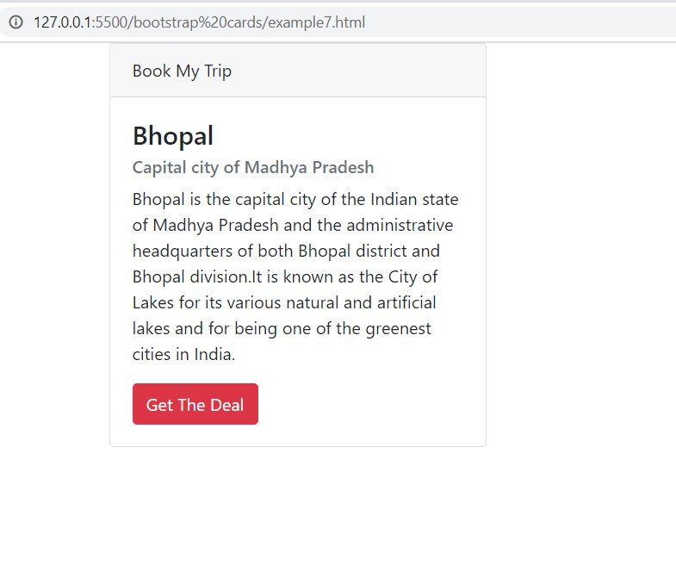
Output

Slide 28
Card Footer
To add a footer to a Card, we need the .card-footer class.

Slide 29
Example
<div class="card">
<div class="card-header">
Book My Trip
</div>
<div class="card-body">
<h4 class="card-title">Bhopal</h1>
<h6 class="card-subtitle mb-2 text-muted">Capital city of Madhya Pradesh</h2>
<p class="card-text">Bhopal is the capital city of the Indian state of Madhya Pradesh ...
</p>
<a href="#" class="btn btn-danger">Get The Deal</a>
<div class="card-footer text-danger">
2 days left
</div>
</div>
</div>

Slide 30
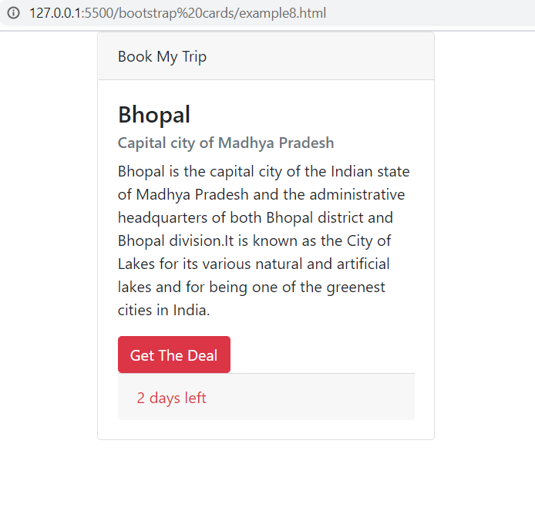
Output

Slide 31
Adding List Groups
We can also add list groups in a Card.
What is a List-Group ?
List groups are unordered lists of items that have a special look:
padding on each item and borders.
To use them, we will need to add the .list-group class on the <ul> tag and .list-group-item on each <li> tag.

Slide 32
Example
<div class="container">
<ul class="list-group">
<li class="list-group-item">The Lord of the Rings</li>
<li class="list-group-item">One Hundred Years of Solitude</li>
<li class="list-group-item">Brave New World</li>
<li class="list-group-item">Gone with the Wind</li>
</ul>
</div>

Slide 33
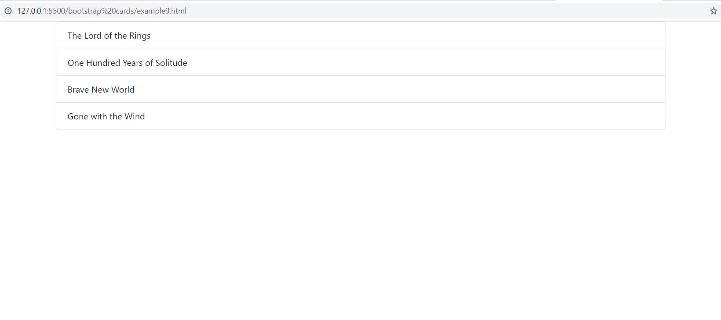
Output

Slide 34
Adding List Groups
Since Bootstrap 5 list groups have a border of their own, we will use the .list-group-flush class to remove that.
And in order for the list to fill the entire width of the card, we will place them outside the .card-body element.

Slide 35
Adding List Groups
If we want to add more components after the .list-group, we can add another .card-body container.
There is no limit on the number of .card-bodys we can use.

Slide 36
Example
<div class="card">
<div class="card-body">
<h4 class="card-title">Bhopal</h1>
<h6 class="card-subtitle mb-2 ">Capital city of Madhya Pradesh</h2>
<p class="card-text">Bhopal is the capital city of . . .
</p>
</div>
<div class="list-group list-group-flush">
<a href="#" class="list-group-item list-group-item-action">
Upper Lake
</a>
<a href="#" class="list-group-item list-group-item-action">Van Vihar</a>
<a href="#" class="list-group-item list-group-item-action">SCA</a>
</div>
<div class="card-body">
<a href="#" class="card-link text-danger">Read more</a>
<a href="#" class="card-link text-warning">Book a Trip</a>
</div>
</div>

Slide 37
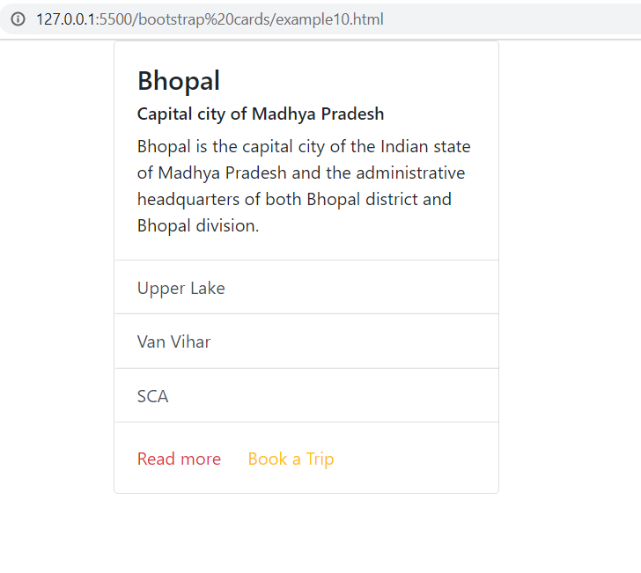
Output

Slide 38
Card Background
We can change the contextual background color for the Cards using the background color utilities we have learnt earlier.

Slide 39
Example
<div class="col-12 col-sm-6 col-lg-4">
<div class="card bg-warning">
<div class="card-body">
<h4 class="card-title">Bhopal</h4>
<h6 class="card-subtitle mb-2">Madhya Pradesh </h6>
<p class="card-text">Bhopal is the capital city . . .</p>
</div>
</div>
</div>
<div class="col-12 col-sm-6 col-lg-4">
<div class="card bg-danger text-white">
<div class="card-body">
<h4 class="card-title">Jaipur</h4>
<h6 class="card-subtitle mb-2">Rajasthan</h6>
<p class="card-text">Planned by Vidyadhar Bhattacharya, . . </p>
</div>
</div>
</div>
. . . . . . .

Slide 40
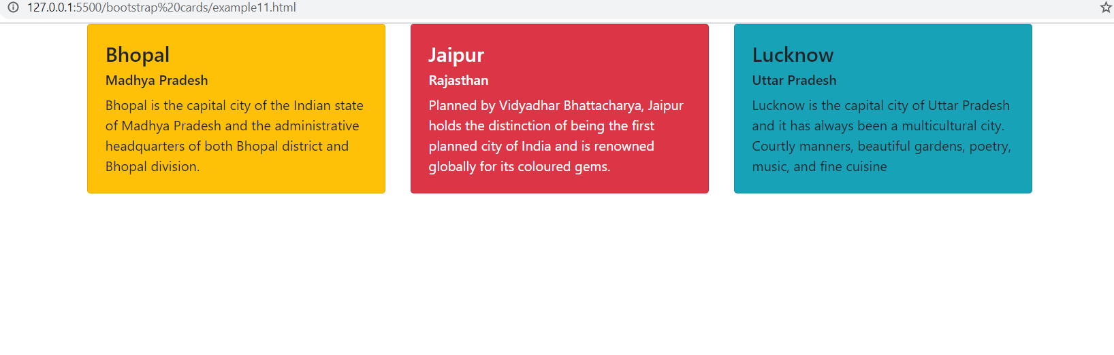
Output

Slide 41
Profile Card
The profile card features a cover and profile photo together with the name and description.
The information is centrally aligned with the .text-center utility.
The profile photo needs a bit of extra styling in order for it to fit into the cover photo.

Slide 42
Example
<div class="container">
<div class="row">
<div class="col-12 col-sm-8 col-md-6 col-lg-4">
<div class="card">
<img class="card-img-top" src="../images/bhopal.jpg" alt="Bhopal">
<div class="card-body text-center">
<img class="avatar rounded-circle" src="../images/sachin.jpg" alt="Sachin">
<h4 class="card-title">Sachin Kapoor</h4>
<h6 class="card-subtitle mb-2 text-muted">Corporate Trainer</h6>
<p class="card-text">Senior corporate trainer with an experience of 20+ years and currently center head and consultant at SCA Bhopal</p>
<a href="#" class="btn btn-info">Follow</a>
<a href="#" class="btn btn-outline-info">Message</a>
</div>
</div>
</div>
</div>
</div>

Slide 43

Output

Slide 44
Product Card
For the product card, we have to use a top image cap with a like button on overlay.
The card body contains information about the product and highlights the price and buy button.

Slide 45
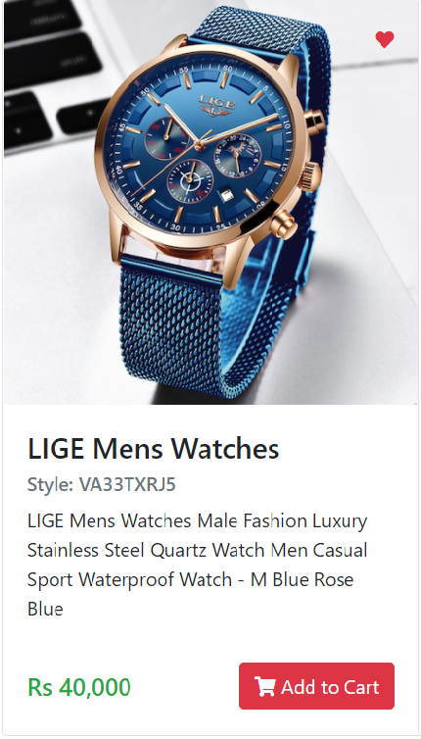
Output

